Slide 1
Chapter 20
Basic Numerical Procedures
郑振龙
厦门大学金融系
课程网站：http://efinance.org.cn
Email: zlzheng@xmu.edu.cn

Slide 2
Approaches to Derivatives Valuation
Trees
Monte Carlo simulation
Finite difference methods

Slide 3
Binomial Trees
Binomial trees are frequently used to approximate the movements in the price of a stock or other asset
In each small interval of time the stock price is assumed to move up by a proportional amount u or to move down by a proportional amount d

Slide 4
Movements in Time Δt
(Figure 20.1, page 428)
p
Su
S
1 – p
Sd

Slide 5
Tree Parameters for asset paying a dividend yield of q
Parameters p, u, and d are chosen so that the tree gives correct values for the mean & variance of the stock price changes in a risk-neutral world
Mean: e^{(r-q)Δt} = pu + (1– p )d
Variance: σ²Δt = pu² + (1– p )d ² – e^{2(r-q)Δt}
A further condition often imposed is u = 1/ d

Slide 6
Tree Parameters for asset paying a dividend yield of q
(continued)
When Δt is small a solution to the equations is

Slide 7
The Complete Tree
(Figure 20.2, page 430)
S₀u⁴
S₀u³
S₀u²
S₀u²
S₀u
S₀u
S₀
S₀
S₀
S₀d
S₀d
S₀d²
S₀d²
S₀d³
S₀d⁴

Slide 8
Backwards Induction
We know the value of the option at the final nodes
We work back through the tree using risk-neutral valuation to calculate the value of the option at each node, testing for early exercise when appropriate

Slide 9
Example: Put Option
(Example 20.1, page 430)
  S₀ = 50; K = 50; r =10%; σ = 40%;
T = 5 months = 0.4167; Δt = 1 month = 0.0833
In this case

Slide 10
Example (continued; Figure 20.3, page 431)

Slide 11
Calculation of Delta
Delta is calculated from the nodes at time Δt

Slide 12
Calculation of Gamma
Gamma is calculated from the nodes at time 2Δt
=0.5(62.99-50)+0.5(50-39.69)

Slide 13
Calculation of Theta
Theta is calculated from the central nodes at times 0 and 2Δt

Slide 14
Calculation of Vega
We can proceed as follows
Construct a new tree with a volatility of 41% instead of 40%.
Value of option is 4.62
Vega is

Slide 15
Trees for Options on Indices, Currencies and Futures Contracts
As with Black-Scholes-Merton:
  For options on stock indices, q equals the dividend yield on the index
  For options on a foreign currency, q equals the foreign risk-free rate
  For options on futures contracts q = r

Slide 16
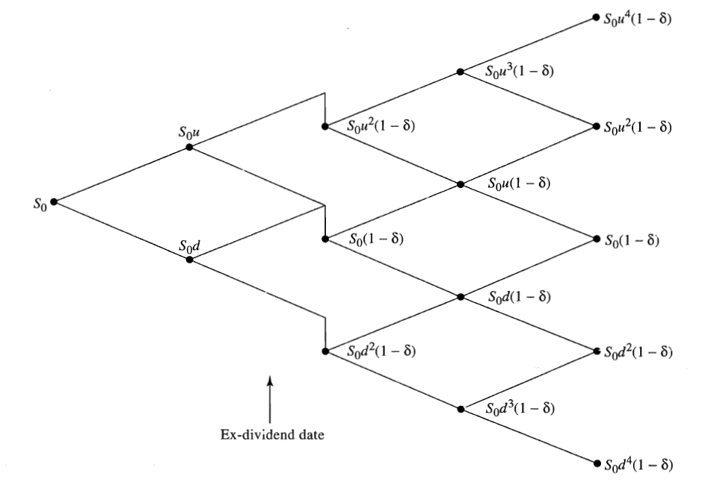
Binomial Tree for Stock Paying Known Dividends Yield

Slide 17
Binomial Tree for Stock Paying Known Dividends
Procedure:
  Construct a tree for the stock price less the present value of the dividends
  Create a new tree by adding the present value of the dividends at each node
This ensures that the tree recombines and makes assumptions similar to those when the Black-Scholes-Merton model is used for European options

Slide 18
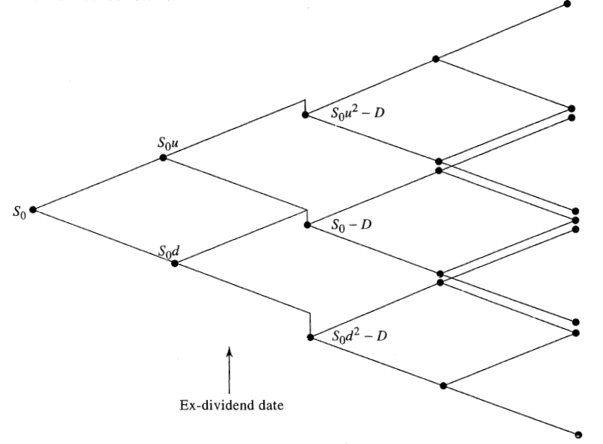
Binomial Tree for Stock Paying Known Dividends

Slide 19
Control Variate Technique
Value American option, f_{A}
Value European option using same tree, f_{E}
Value European option using Black-Scholes –Merton, f_{BS}
Option price =f_{A}+(f_{BS} – f_{E})

Slide 20
Alternative Binomial Tree
(page 442)
Instead of setting u = 1/d we can set each of the 2 probabilities to 0.5 and

Slide 21
Trinomial Tree (Page 444)
Su
p_{u}
p_{m}
S
S
p_{d}
Sd

Slide 22
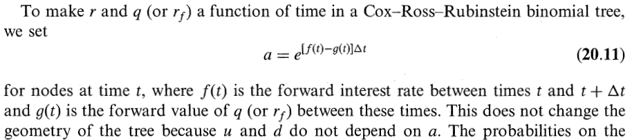
Time Dependent Parameters in a Binomial Tree (page 445)
Making r or q a function of time does not affect the geometry of the tree. The probabilities on the tree become functions of time.

Slide 23

Time Dependent Parameters in a Binomial Tree (page 445)
We can make $σ$ a function of time by making the lengths of the time steps inversely proportional to the variance rate. The values of u and d are then always the same and the tree recombines.

Slide 24
Monte Carlo Simulation and π
How could you calculate π by randomly sampling points in the square?

Slide 25
Monte Carlo Simulation and Options
When used to value European stock options, Monte Carlo simulation involves the following steps:
1. Simulate 1 path for the stock price in a risk neutral world
2. Calculate the payoff from the stock option
3. Repeat steps 1 and 2 many times to get many sample payoffs
4. Calculate mean payoff
5. Discount mean payoff at risk free rate to get an estimate of the value of the option

Slide 26
Sampling Stock Price Movements
In a risk neutral world the process for a stock price is
We can simulate a path by choosing time steps of length Δt and using the discrete version of this
where ε is a random sample from φ(0,1)

Slide 27
A More Accurate Approach
(Equation 20.15, page 448)

Slide 28
Extensions
When a derivative depends on several underlying variables we can simulate paths for each of them in a risk-neutral world to calculate the values for the derivative

Slide 29
Sampling from Normal Distribution (Page 450)
In Excel =NORMSINV(RAND()) gives a random sample from φ(0,1)

Slide 30
To Obtain 2 Correlated Normal Samples
Obtain independent normal samples x₁ and x₂ and set
Use a procedure known as Cholesky’s decomposition when samples are required from more than two normal variables (see page 450)

Slide 31
Standard Errors in Monte Carlo Simulation
The standard error of the estimate of the option price is the standard deviation of the discounted payoffs given by the simulation trials divided by the square root of the number of observations.

Slide 32
Application of Monte Carlo Simulation
Monte Carlo simulation can deal with path dependent options, options dependent on several underlying state variables, and options with complex payoffs
It cannot easily deal with American-style options

Slide 33
Determining Greek Letters
For Δ:
1. Make a small change to asset price
2. Carry out the simulation again using the same random number streams
3. Estimate Δ as the change in the option price divided by the change in the asset price
Proceed in a similar manner for other Greek letters

Slide 34
Variance Reduction Techniques
Antithetic variable technique（对偶变量技术）
Control variate technique
Importance sampling（虚值部分不用抽）
Stratified sampling（分层抽样，抽样次数已知）
Moment matching
Using quasi-random sequences（平衡抽样）

Slide 35


Antithetic variable technique
在一次模拟运算中，计算两个期权价值：用通常方法计算得到$f_{1}$，改变计算 中所有的$ε$的符号得到$f_{2}$，这条模拟路径得到的期权价值是$f_{1}$和$f_{2}$的平均值
当一次模拟中的一个 值高于真实值时，另一个值必然偏低，反之亦然。从而大大降低方差。

Slide 36

Control variate technique
和二叉树模型中的控制方差技术相同，只是在蒙特卡罗中，对于两个类似的期权，必须使用相同的随机数流和相同的 平行地进行两次模拟

Slide 37
Importance sampling
适合于那些大部分路径对定价意义不大的情形，比如一个深度虚值的看涨期权，大部分路径上的终值为零。这时我们只选取那些标的资产的到期日价值大于其执行价格的路径，即重要路径为期权定价。这样等于缩小了样本空间，从而加速了收敛。
最后从重要路径中获得的贴现平均值还要再乘上 （重要路径出现的概率），才能获得期权价值的最终估计值。

Slide 38
Stratified sampling
将市场变量在未来时刻的基本概率分布分为多个区间，并根据它的概率从每个间隔中抽样
假设存在10个可能性基本相等的区间，抽样方案就可以设计为每个间隔中抽取的样本各占10％
如果样本间隔的数量很多，我们就可以取每个区间内的均值或是中位数作为该区间的代表样本值。这样也可以提高模拟运算的效率
参见M. Curran, “Strata Gems,” RISK, (March 1994), 70-71; B. Moro, “The Full Monte,” RISK, (February 1985), 57-58.

Slide 39
Moment matching
对从标准正态分布中抽取的样本进行调整，使其一阶矩、二阶矩甚至高阶矩都匹配。
样本矩匹配法可以节省计算时间，但是由于所有的抽样值都要保存到模拟运算结束，存储负担很重

Slide 40
Using quasi-random sequences
在准随机序列抽样法中，每次抽样都试图填补之前已存在的样本之间的空缺，使得抽取的样本值总是能大致均匀地分布在整个概率空间中，使模拟的收敛速度得到改进。

Slide 41
Sampling Through the Tree
Instead of sampling from the stochastic process we can sample paths randomly through a binomial or trinomial tree to value a derivative
At each node that is reached we sample a randon number between 0 and 1. If it is between 0 and p, we take the up branch; if it is between p and 1, we take the down branch
如果一条路径经过任何给定结点的比例等于（或接近于）该结点被到达的概率，就被称为代表路径.
参见D. Mintz, “Less is more,” RISK, 10, 7 (July 1997), 42-45

Slide 42
主要优缺点
主要优点：
  应用简单，无需深刻理解定价模型
  可给出标准误和置信区间
  适用情形广泛
    欧式衍生产品
    回报路径依赖
    回报取决于多个标的资产
主要缺点：
  难以处理提前执行的情形（美式期权定价参见附录）
  为了达到一定的精确度，一般需要大量的模拟运算

Slide 43
Finite Difference Methods
Finite difference methods aim to represent the differential equation in the form of a difference equation
We form a grid by considering equally spaced time values and stock price values
Define ƒ_{i,j} as the value of ƒ at time iΔt when the stock price is jΔS

Slide 44
The Grid

Slide 45
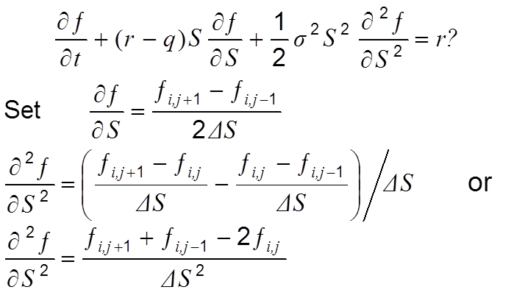
Finite Difference Methods
(continued)

Slide 46
Implicit Finite Difference Method

Slide 47
显性有限差分法－方法1
假设 (i, j) 点的 与 (i + 1, j) 的对应值相等，即

Slide 48
显性有限差分法 －方法1
相应的差分方程修改为
其中

Slide 49
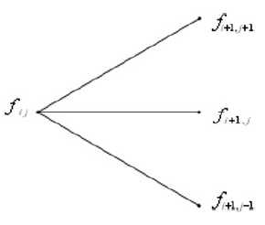
理解显性有限差分法
可以看出 ，这说明某一时刻某格点的期权价值等于下一时刻相邻三个格点的期权价值风险中性期望值的现值。
显性有限差分法可以理解为从格点图外部推知内部格点期权价值的方法。

Slide 50
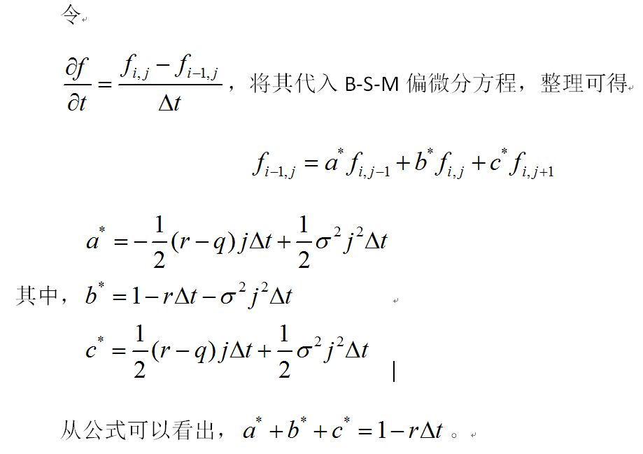

显性有限差分法－方法2
如果我们采用${∂f}/{∂t}$ 的另一种定义，而保留 ${∂f}/{∂S}$和 ${∂^{2}f}/{∂S^{2}}$的定义就可以得到另一种显性有限差分法。

Slide 51
Implicit vs Explicit Finite Difference Method
The explicit finite difference method is equivalent to the trinomial tree approach
The implicit finite difference method is equivalent to a multinomial tree approach

Slide 52
Implicit vs Explicit
Finite Difference Methods (Figure 20.16, page 461)
ƒ_{i , j +1}
ƒ_{i +1, j +1}
ƒ_{i , j}
ƒ_{i +1, j}
ƒ_{i , j}
ƒ_{i +1, j}
ƒ_{i , j –1}
ƒ_{i +1, j –1}
Implicit Method
Explicit Method

Slide 53
隐性和显性有限差分方法的比较
显性方法计算比较直接方便，无需像隐性方法那样需要求解大量的联立方程，工作量小，易于应用
但显性方法的三个“概率”可能小于零，导致了这种方法的不稳定，它的解有可能不收敛于偏微分方程的解。而隐性方法则不存在这个问题，它始终是有效的

Slide 54
有限差分方法和树图方法的比较
相同之处：都用离散的模型模拟资产价格的连续运动
不同之处
  树图方法中包含了资产价格的扩散和波动率情形；有限差分方法中的格点则是固定均匀的，只是参数进行了相应的变化，以反映改变了的扩散情形。
  有限差分方法比树图方法灵活
显性有限差分方法与三叉树图相当类似，但显性差分方法中的隐含概率可能小于零，这也是这一方法的主要缺陷。

Slide 55
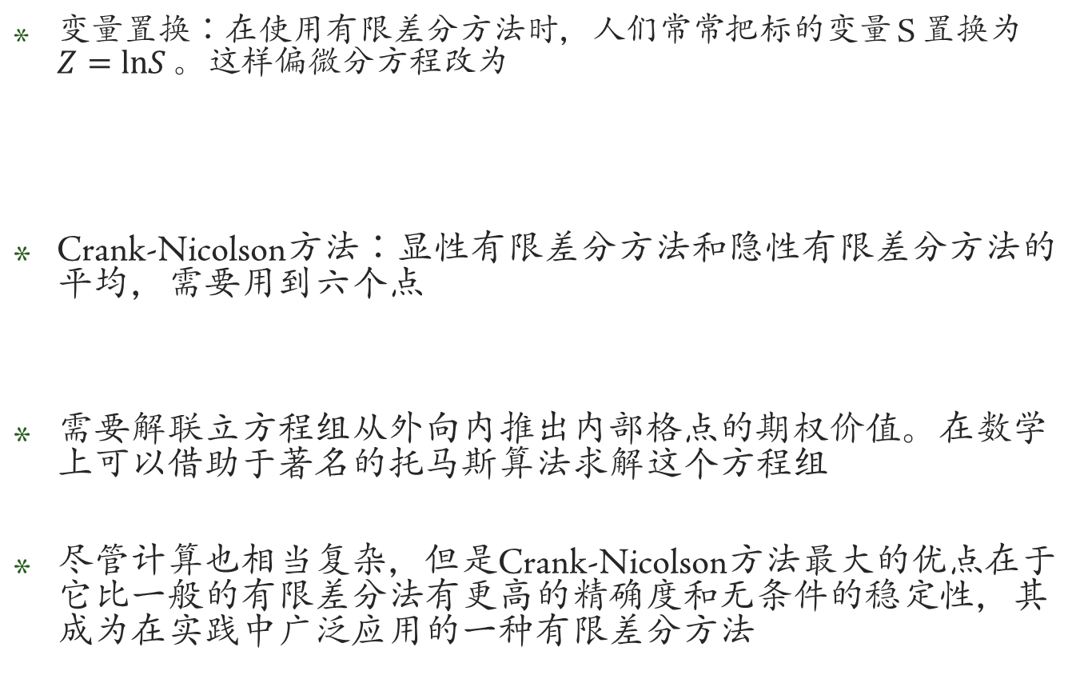
有限差分方法的改进
变量置换：在使用有限差分方法时，人们常常把标的变量 S 置换为$Z=lnS$ 。这样偏微分方程改为
Crank-Nicolson方法：显性有限差分方法和隐性有限差分方法的平均，需要用到六个点
需要解联立方程组从外向内推出内部格点的期权价值。在数学上可以借助于著名的托马斯算法求解这个方程组
尽管计算也相当复杂，但是Crank-Nicolson方法最大的优点在于它比一般的有限差分法有更高的精确度和无条件的稳定性，其成为在实践中广泛应用的一种有限差分方法

Slide 56
有限差分方法的应用
有限差分方法和树图方法相当近似的，可以解决相同类型的衍生证券定价问题，尤其是那些具有提前执行特征的期权
有限差分方法可以进一步推广到多个标的变量的情形，但超过三个变量时蒙特卡罗模拟方法较为有效
有限差分方法不善于处理期权价值取决于标的变量历史路径的情况

Slide 57

Any Questions？
Notes:
57

Slide 58


