Slide 1
Ch3. Contingent Claims Markets

Slide 2
Brief introduction
In the frame of complete market, we look forward to see the equation p=E(mx) more intuitive.
The structure is as follows:
  Contingent Claims
  Risk-Neutral Probabilities
  State Diagram and Price Function

Slide 3
3.1 Contingent Claims
A contingent claim is a security that pays one dollar (or one unit of the consumption good) in one state s only tomorrow.
pc(s) is the price today of the contingent claim. （状态价格）

Slide 4
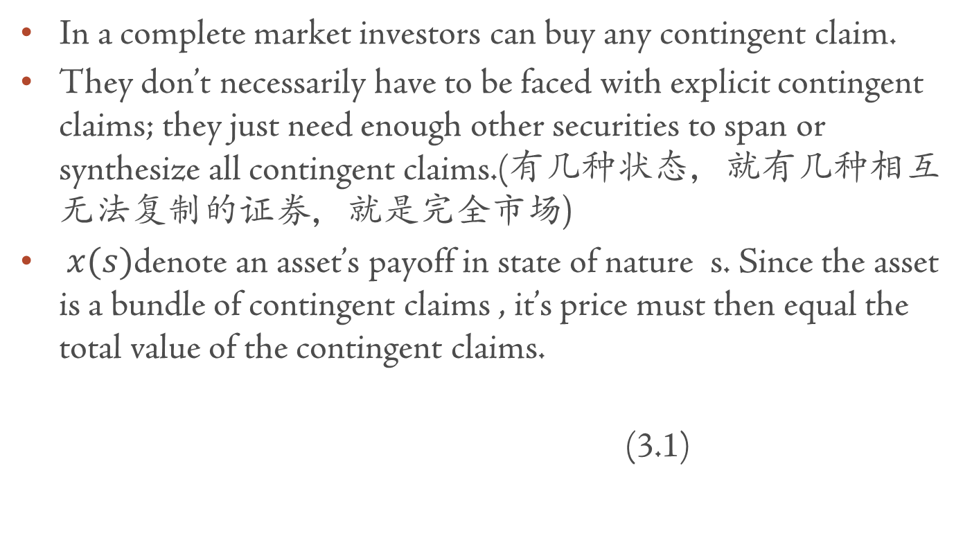
Complete market

Slide 5
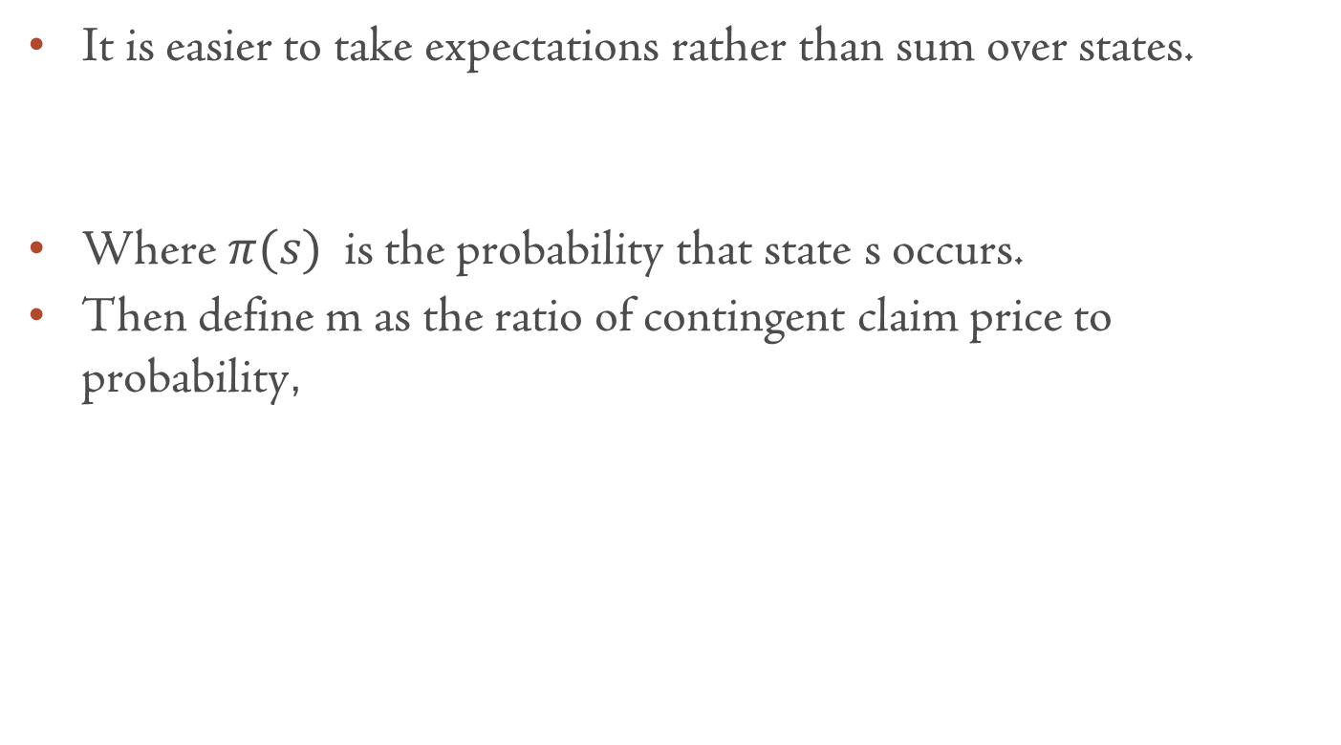

Slide 6
Conclusion about discount factor
Now we can write the bundling equation as an expectation,
If there are complete contingent claims, a discount factor exists, and it is equal to the contingent claim prices divided by probabilities.

Slide 7
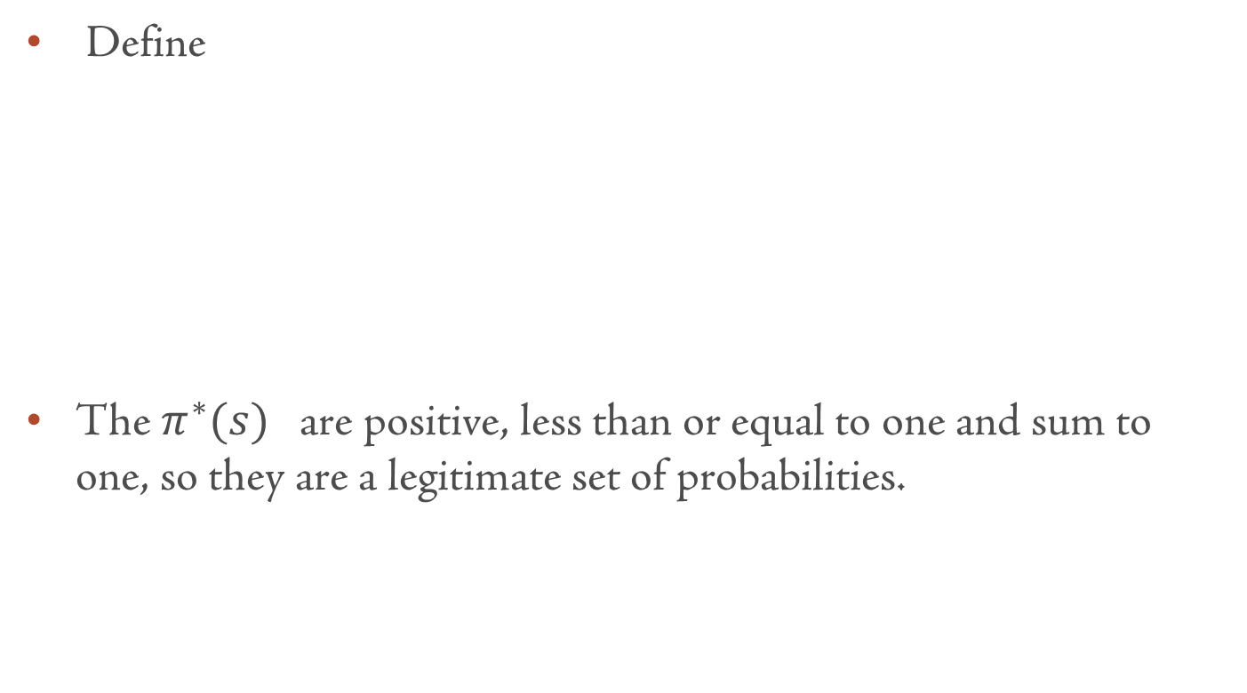
3.2 Risk- neutral probabilities

Slide 8
Risk- neutral probabilities (2)
Then we can rewrite the asset pricing formula as:
We use the notation E* to remind us that the expectation uses the risk neutral probabilities π*instead of the real probabilities π.

Slide 9
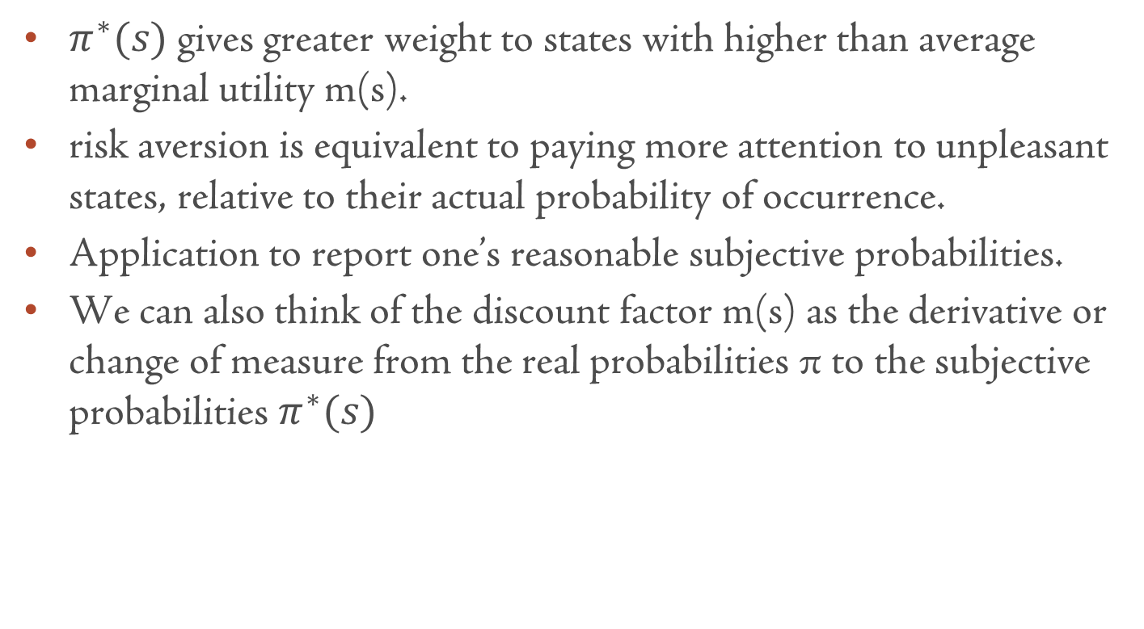

Slide 10
连续时间
在完全市场中，两者的风险源相同。
From (1.35),we have

Slide 11
风险中性定价
在风险中性世界，风险价格必须等于0，即

Slide 12
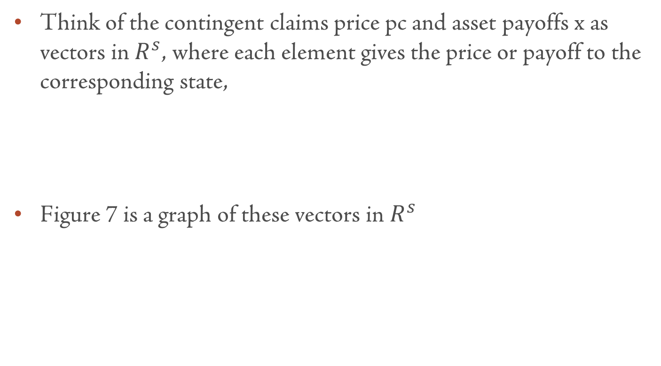
3.3 State Diagram and Price Function

Slide 13
图7状态价格与回报
状态2回报
P=2
1/R_{f}
R_{f}
pc
P=1（收益率）
1/R_{f}
状态1回报
P=0(超额收益率)

Slide 14

回报空间中点与点的关系
45度线把平面切成两块。
与A同边的证券与A证券完全正相关，另一边的证券与A完全负相关。45度线上的无风险证券与A不相关。
在不考虑概率情况下，越接近45度线的证券风险越小。
A
$${45}^{°}$$
B

Slide 15
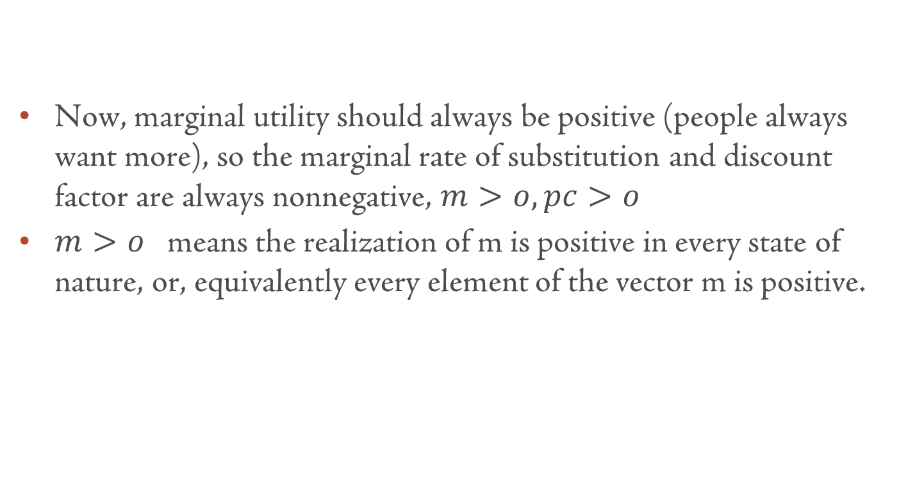
The contingent claims price vector pc points in to the positive orthant

Slide 16
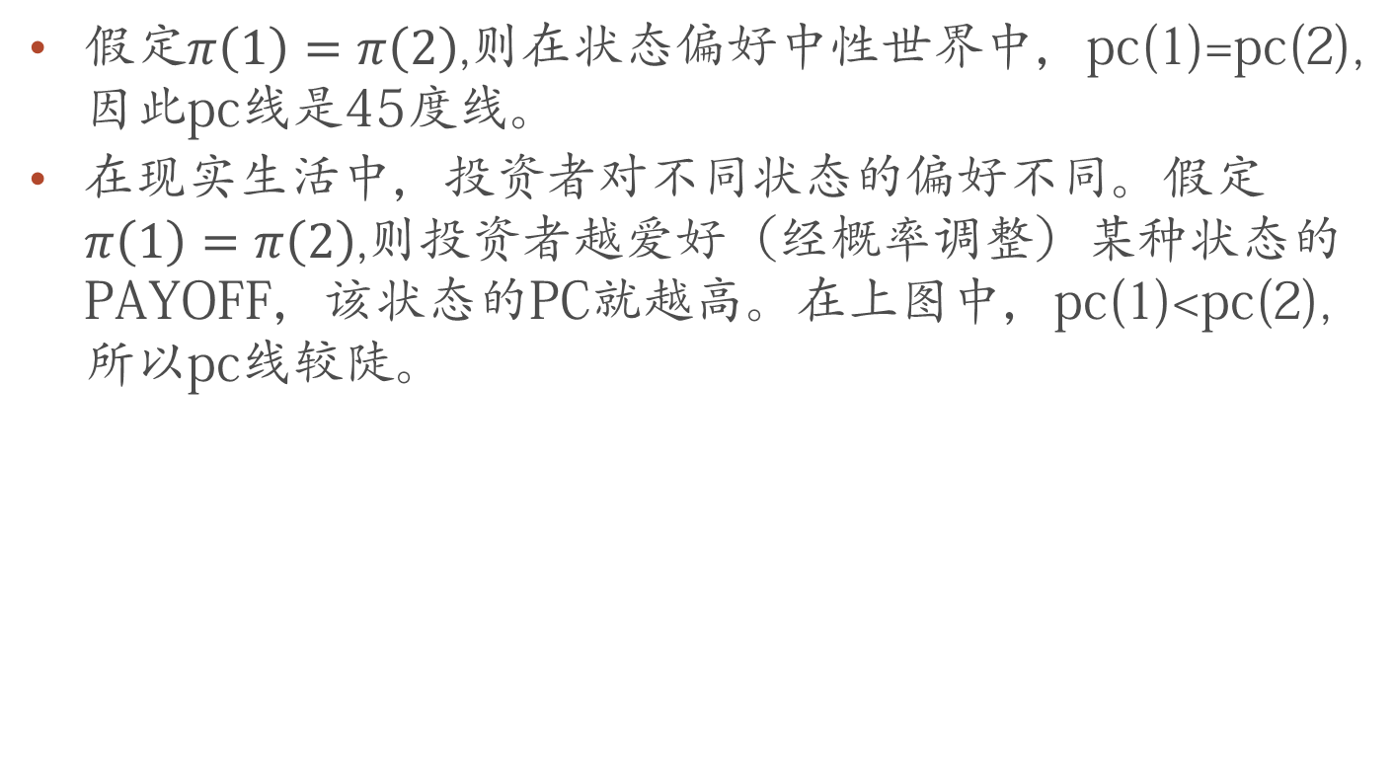
pc线的斜率
假定$π\left(1\right)=π\left(2\right)$,则在状态偏好中性世界中，pc(1)=pc(2),因此pc线是45度线。
在现实生活中，投资者对不同状态的偏好不同。假定$π\left(1\right)=π\left(2\right)$,则投资者越爱好（经概率调整）某种状态的PAYOFF，该状态的PC就越高。在上图中，pc(1)<pc(2),所以pc线较陡。

Slide 17
PC线的长度
对无风险资产定价可知：
pc(1) R_{f} ＋pc(2) R_{f} ＝1,可得：
pc(1)＋pc(2)=1/(R_{f})
可见，pc向量一定在0（1/R_{f} ）（1/R_{f}）这个三角形中。

Slide 18
The set of payoffs with any given price lie on a (hyper)plane perpendicular to the contingent claim price vector
Since the price of the payoff x must be given by its contingent claim value,
Interpreting pc and x as vectors, this means that the price is given by the inner product of the contingent claim price and the payoff.
If two vectors are orthogonal —— if they point out from the origin at right angles to each other —— then their inner product is zero.
The set of all zero price payoffs must lie on a plane orthogonal to the contingent claims price vector, as shown in figure 7.

Slide 19
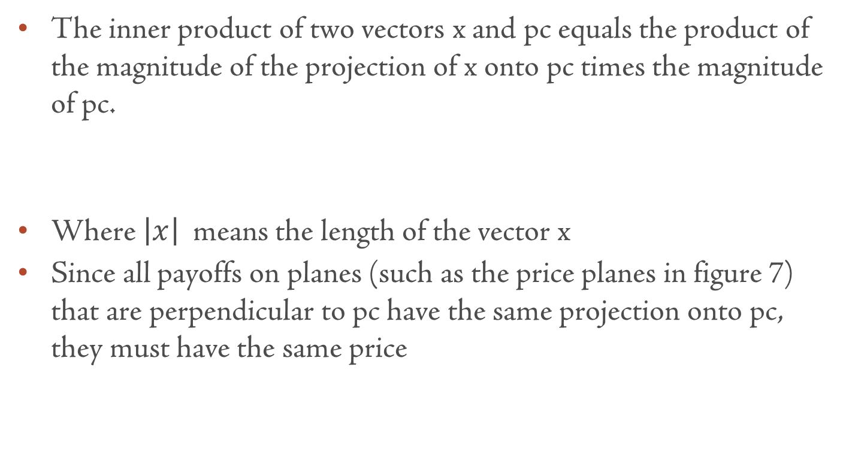

Slide 20
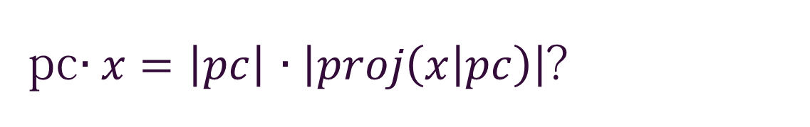
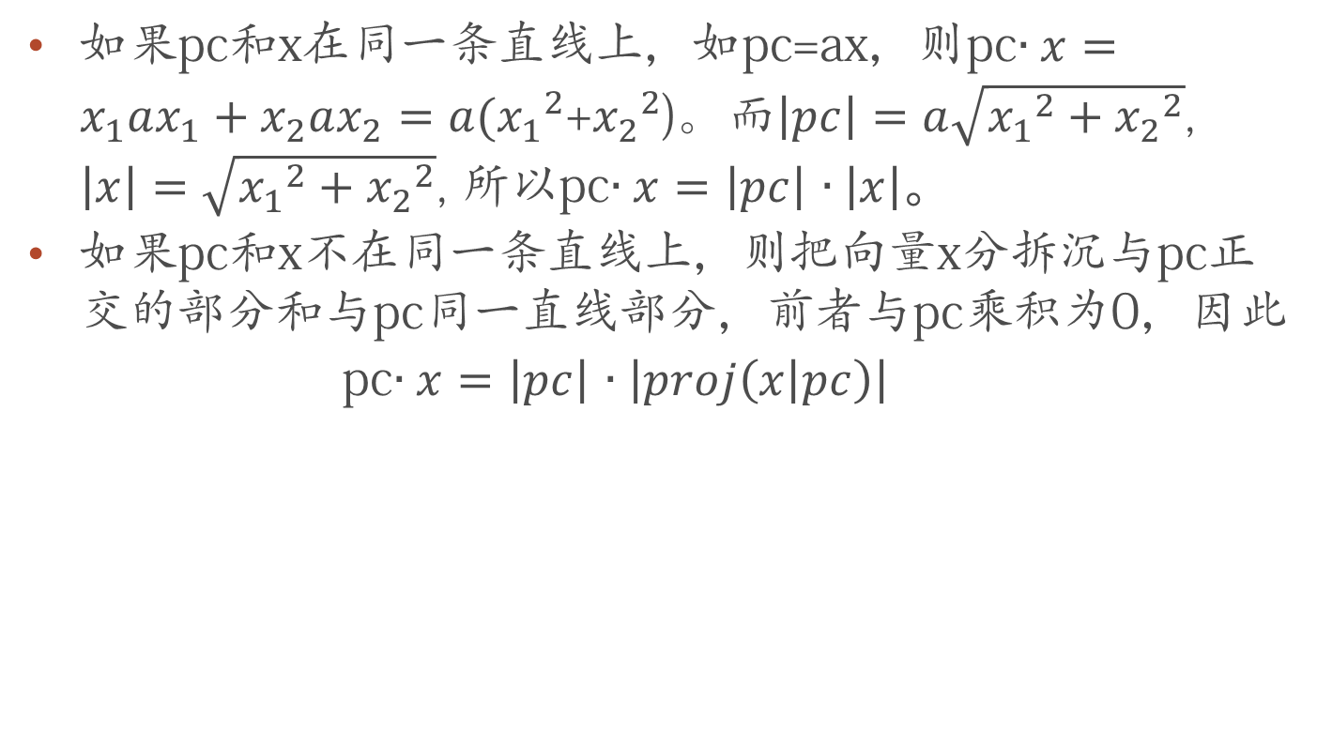

Slide 21
Planes of constant price move out linearly, and the origin x= 0 must have a price of zero.
If payoff y= 2x, then its price is twice the price of x

Slide 22
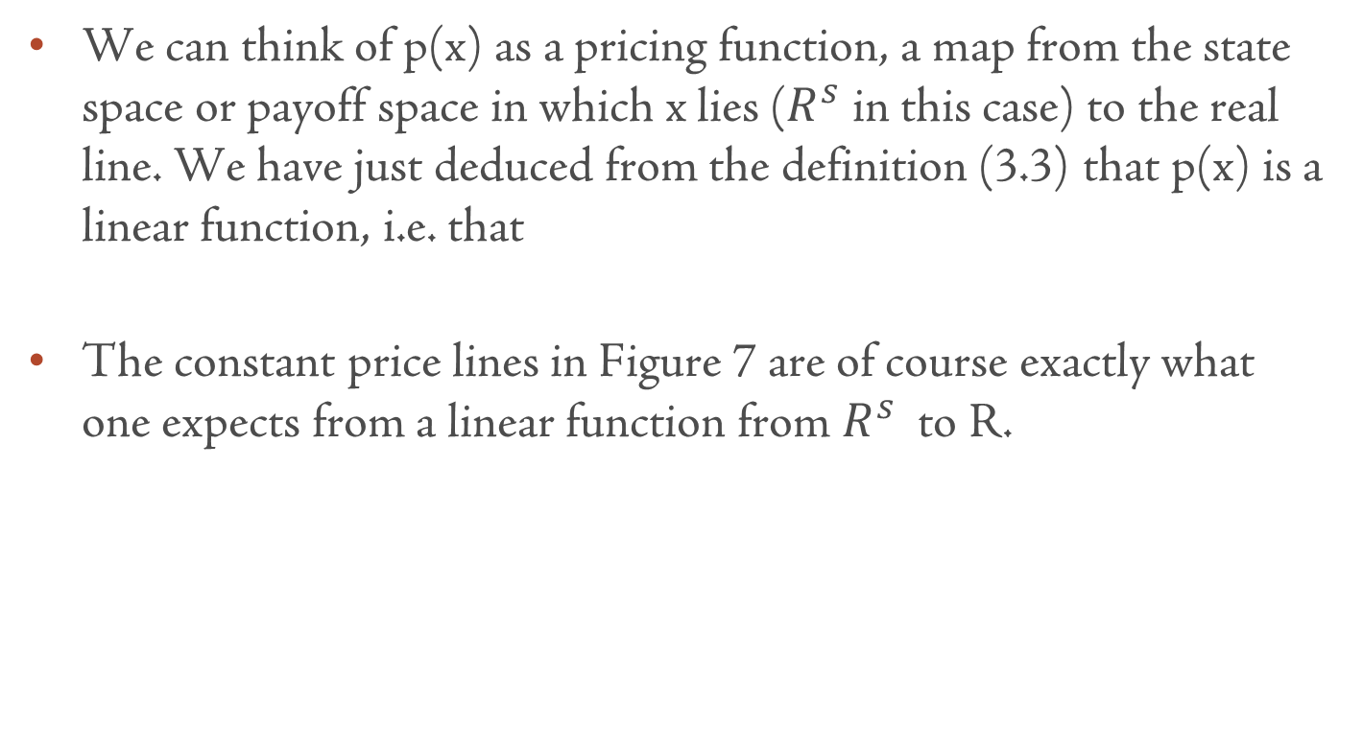

Slide 23
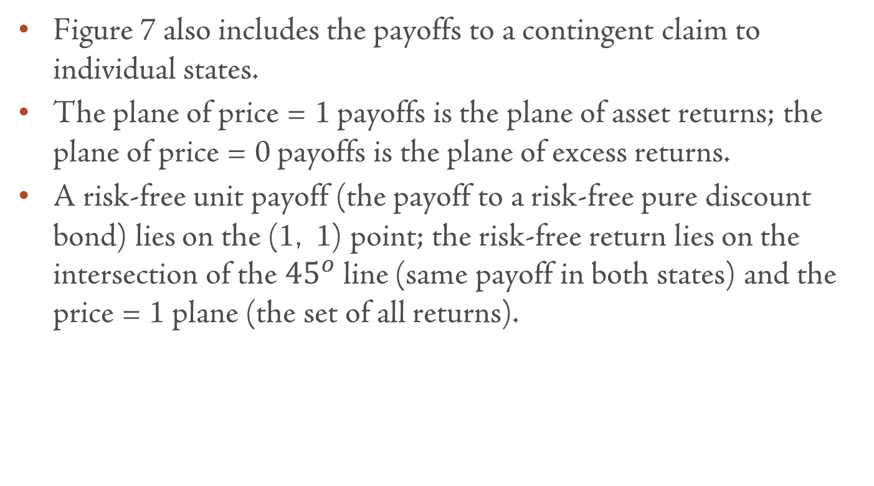

Slide 24
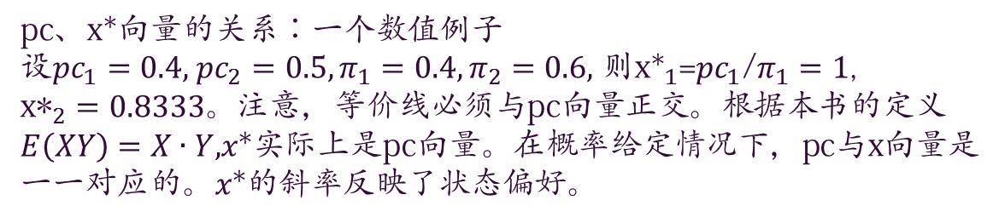

$R_{f}$右下边的证券由于与$x^{∗}完全$正相关，其贝塔系数等于${σ_{A}}/{σ_{R∗}}$,其预期收益率都应小于$R_{f}$，越右越小； 而$R_{f}$左上边的证券由于与$x^{∗}$完全负相关，其贝塔系数等于$−{σ_{A}}/{σ_{R∗}}$，其预期收益率都应大于$R_{f}$，越左越大。01线上的点与线外的点不相关。
状态2回报
R_{f}
1
R*
x*
P=1(收益率）
pc
状态1回报
P=0(超额收益率）

Slide 25
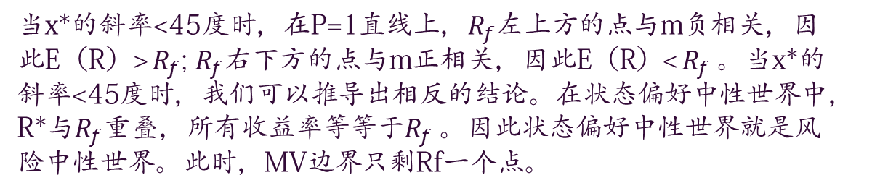
状态2回报
X*
R_{f}
1
R*
x*
P=1(收益率）
pc
R^{e*}
状态1回报
P=0(超额收益率）

